Slide 1
What Methods and ethics of Inquiry are used in linguistics research?
Grace Anderson
Lin 211 Spotlight Lecture
October 12, 2026
Notes:
Outline the spotlight lectures:
Regular lectures are to introduce linguistic concepts (what is linguistics?)
Spotlight lectures are about how we do linguistics
Stella’s spotlight lecture: about forming research questions
what kinds of questions can we ask? What makes a good research question? (grounded in previous research; practical; specific)
Next lecture: How do we find relevant linguistic sources?
This lecture: how do we conduct the research?
What does this question mean?

Slide 2
This is really two questions:
methods
ethics
Once we have a research question, how do we go about answering it?
How can we design our research in a way that minimizes harm?

Slide 3
LING LINK:
THINK BACK TO THE FIRST SPOTLIGHT LECTURE
Research question: “Where, exactly, do people use different words for a carbonated beverage?”
With the people around you, brainstorm for 2-3 minutes some ways that you can go about answering this question.
Be specific! “Ask them” is not enough detail…
Who are you asking?
How are you asking them?
What question are you asking?
etc.

Slide 4
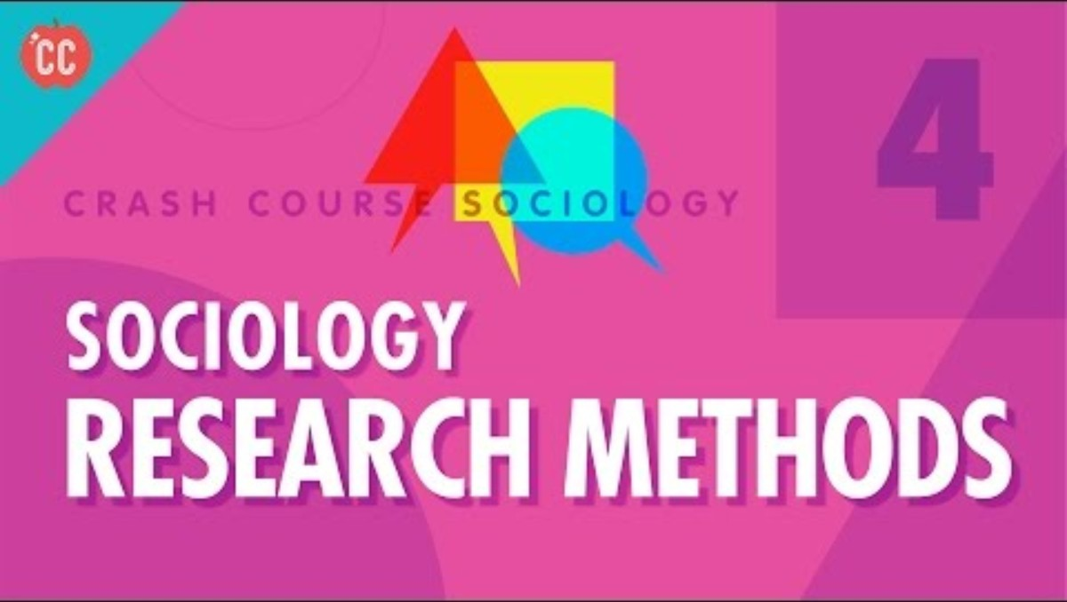
Methods:
How do we answer questions?
https://youtu.be/QwhK-iEyXYA
The research method:
Start with a question
State a hypothesis
Collect data
Use your data to test your hypothesis
This video is specifically for sociology, but we use the same processes in Linguistics!

Slide 5
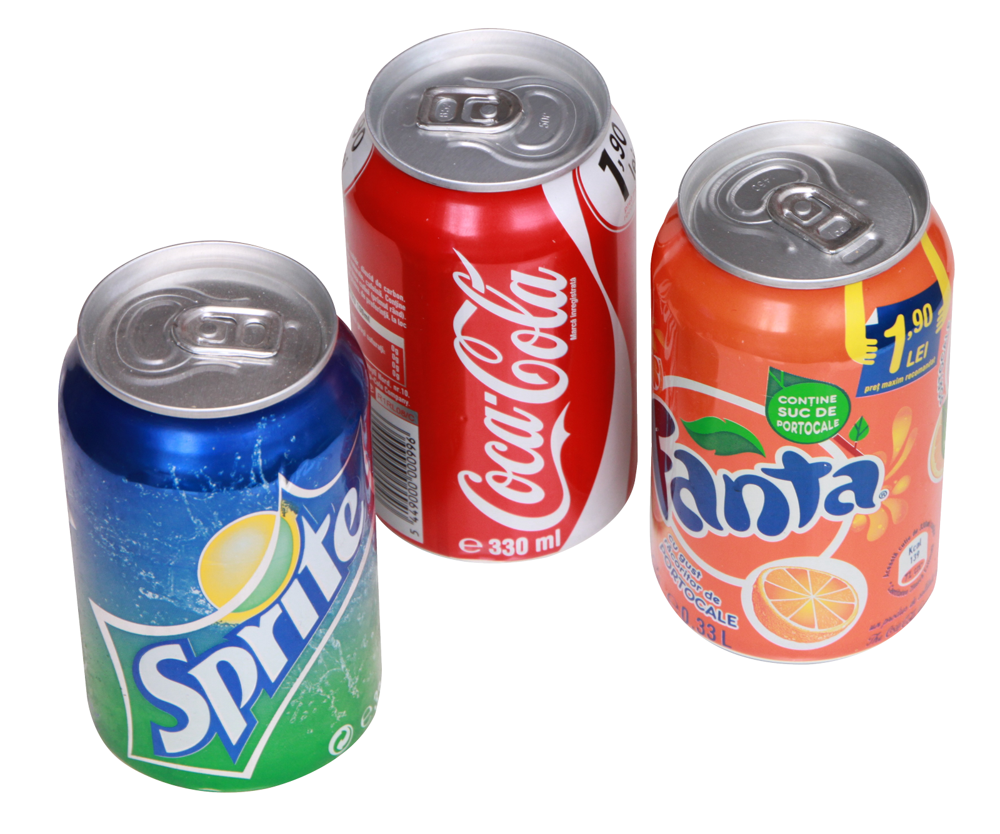
Where, exactly, do people use different words for a carbonated beverage?
A specific, practical research question based on previous research:

Slide 6
State a hypothesis
Define and operationalize your variables:
Make a hypothesis about the relationship between the variables:
“If a speaker is from a state in the Midwest, then they’ll be more likely to use the word “pop” to describe carbonated drinks.”
Region
Region:
State of origin
Variant
Variant:
Soda, pop, coke, fizzy drink, soft drink, etc.
Independent variable
Dependent variable
Notes:
Operationalizing a variable makes it measurable - you’re defining the potential values it can have
You have to be strategic.
Region:
How specific? Country / state / county / city / home address. Based on our question, what makes the most sense?
When? Where someone was born? Where they live now? Where they spent the most time?
In this example, region is the independent variable (the variable we think is affecting the linguistic behavior) and variant is the dependent variable (the variable we think is affected by changes in region).
You might have multiple hypotheses
Note: this hypothesis is still pretty unspecific. What’s the “Midwest”?

Slide 7
Methods of collecting data:
Experiments
Participants are divided into a control group and experimental group(s)
Researchers manipulate the independent variable(s) and then measure the dependent variable(s)
Surveys
Participants respond to a prepared set of questions
Participants are sampled from a population of interest
Participant observation
Researchers observe people in their daily routines
Often, this method is exploratory and descriptive
Existing resources
Researchers use existing data collected by others (e.g. government agencies or other researchers)
Notes:
For the carbonated drinks question:
Population: Americans English speakers
Sample:
Survey with questions targeting:
The speaker’s word for a carbonated/fizzy drink ?
Some variant of “where are you from?” depending on how you define the region variable

Slide 8
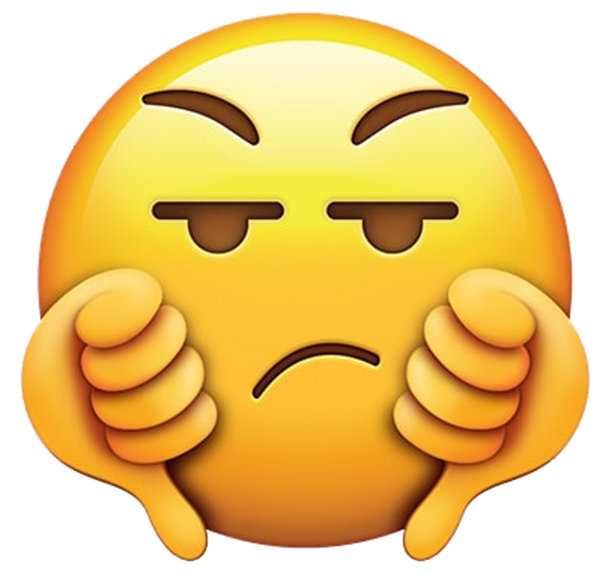

surveys
The phrasing and order of questions can be important!
  Yes/No vs. Multiple choice vs. Open-ended
  Order of questions
  Phrasing of questions
What’s your word for “pop”?
Which word do you use: “soda” or “pop”?
What’s your generic term for a sweetened carbonated beverage?
Notes:
Be careful! Structure of a survey / questions can bias the answers.

Slide 9
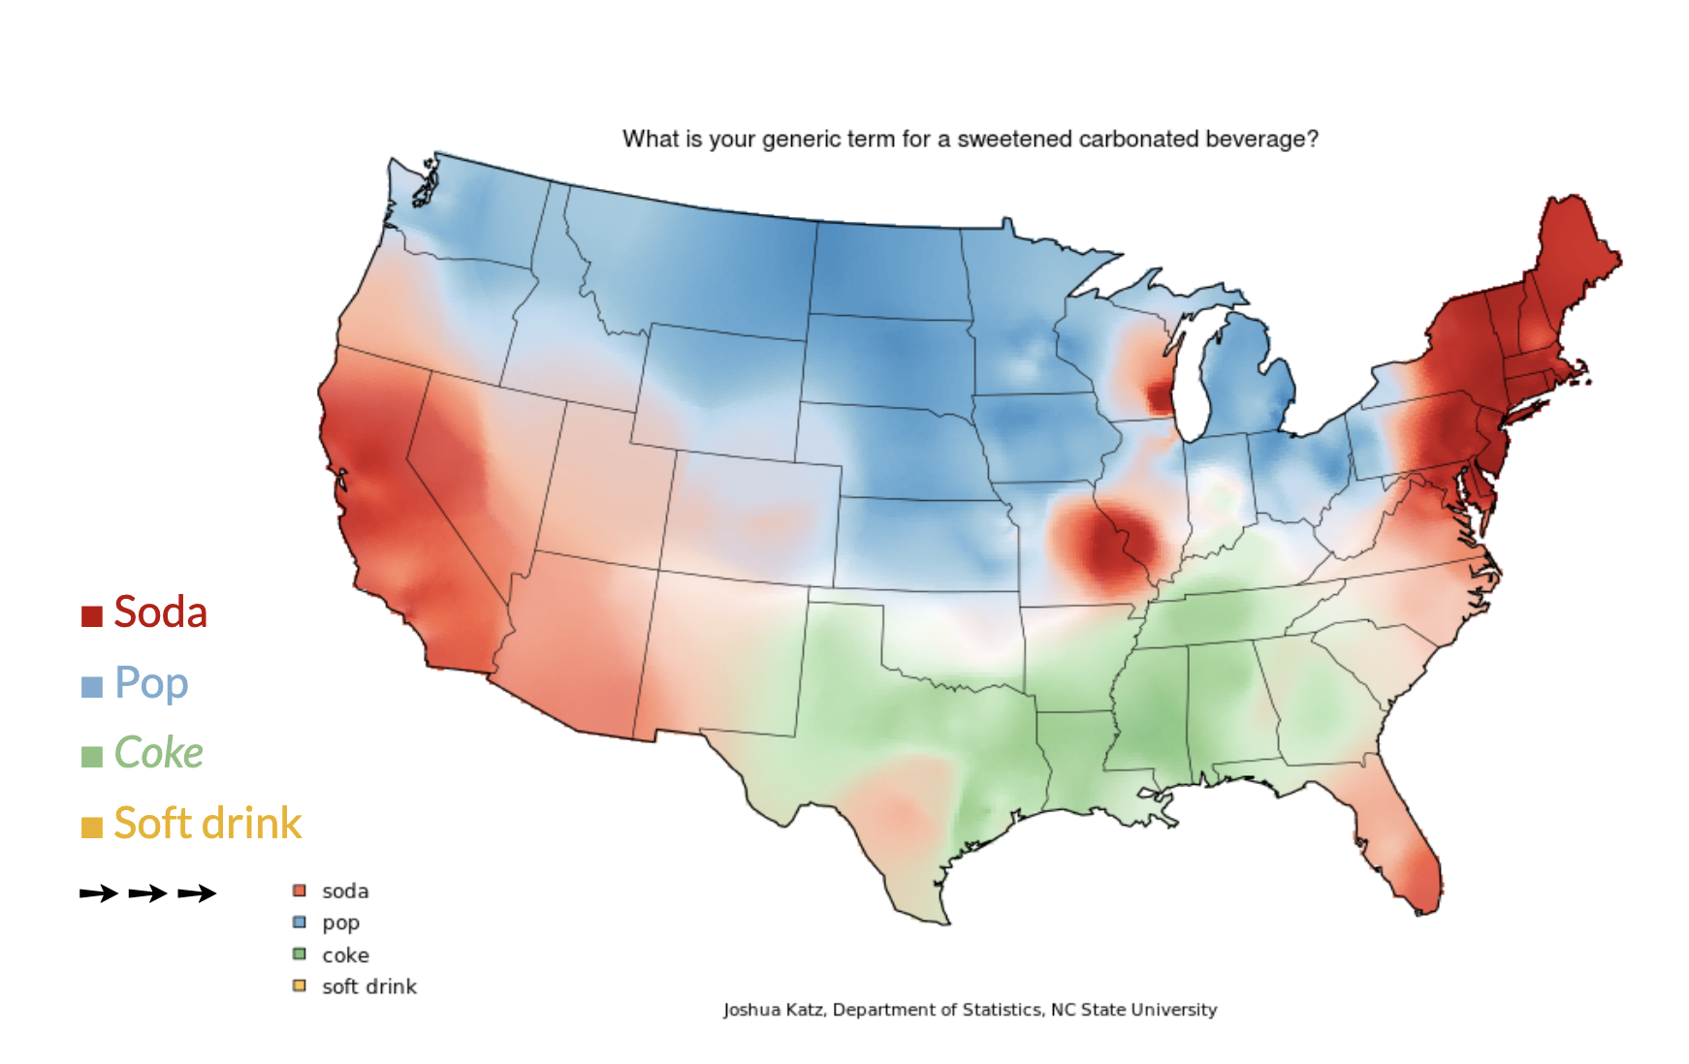
Test your hypothesis
“If a speaker is from a state in the Midwest, then they’ll be more likely to use the word “pop” to describe carbonated drinks.”
Notes:
If the data supports your hypothesis, hooray!
If not, it sometimes contradicts your hypothesis in interesting ways.
Either way, the next step is to take your new observations and keep asking questions!

Slide 10
Ask a question
Test your hypothesis
State a hypothesis
Collect data

Slide 11
What does it mean to do research ethically?

Slide 12
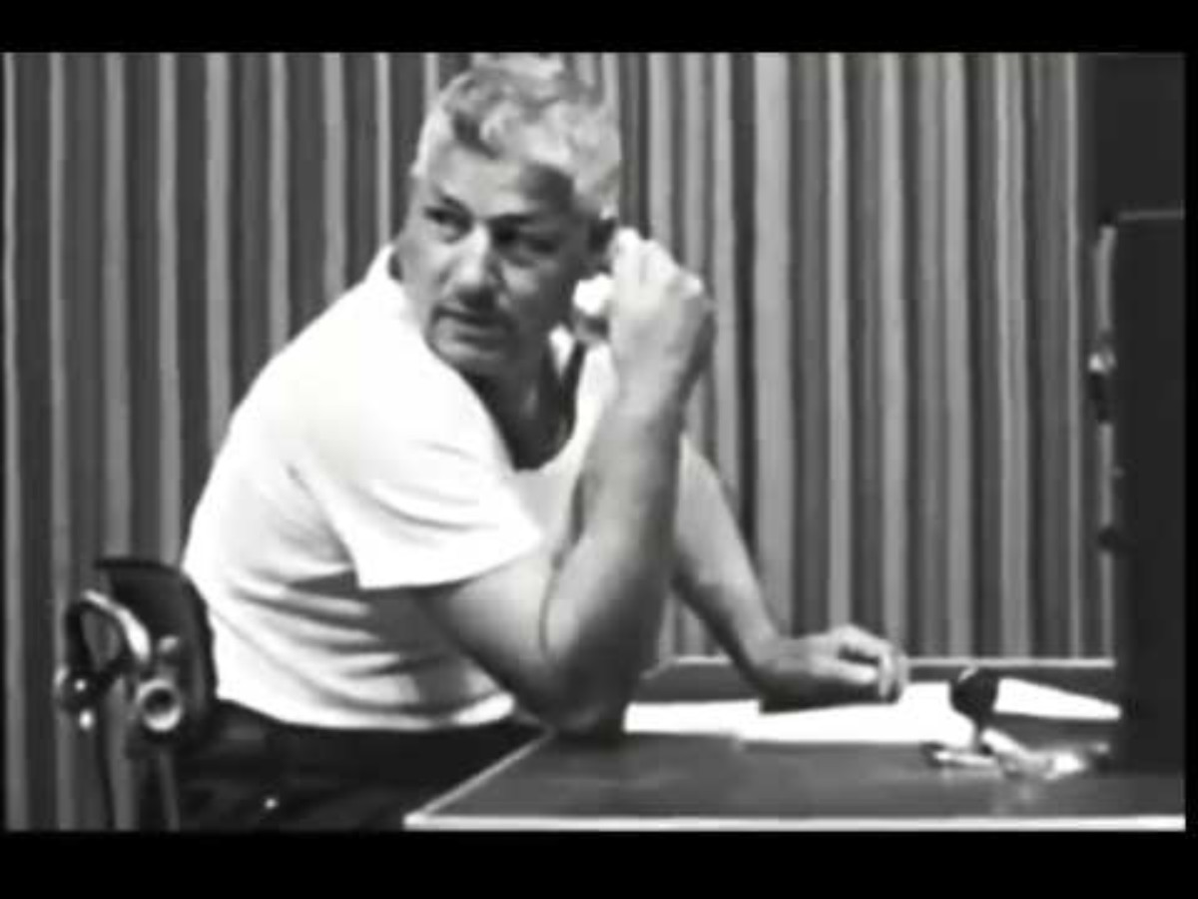
Milgram Experiment
Please continue.
Could you please continue?
Continue.
Will you continue?
https://youtu.be/Kzd6Ew3TraA
Notes:
Temperature check – what makes an experiment (un)ethical?

Slide 13
Was this an ethical experiment?

Slide 14
Milgram Experiment
As conducted, is unethical. Why?
Psychological harm for participants
No clear way to end the experiment
Insufficient or absent debrief after deception
Notes:
This one was really egregiously unethical… but there are some examples that might be less obvious

Slide 15

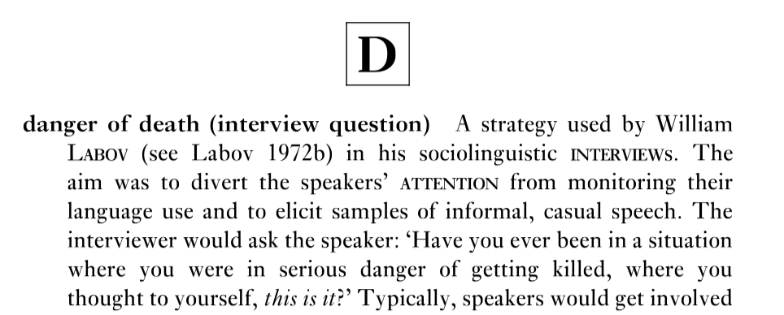
William Labov’s Sociolinguistic Interview
Can you think of a problem with this question?
Why might the interviewee sometimes end the interview early?
Text from: https://www.degruyter.com/document/doi/10.1515/9781474472968-006/pdf?licenseType=restricted
Audio from: https://soundcloud.com/xander-470783300/labov-dod-recreation
Notes:
An example from linguistics
not inherently unethical, but it can be distressing
use it sensitively
obtain informed consent
let participants decline to respond or stop the interview

Slide 16
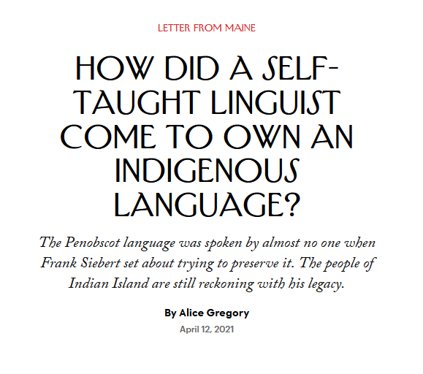

https://www.newyorker.com/magazine/2021/04/19/how-did-a-self-taught-linguist-come-to-own-an-indigenous-language
Who did this research stand to benefit / harm?
What happened to the data after the research was concluded?
Notes:
There’s a lot to unpack from this article, but key points:
Who was this research for?
This research has had benefits for the Penobscot community
Language revitalization efforts make use of Siebert’s wordlists and dictionary.
Carol Dana leads lessons and activities with students, trains instructors, helped the Penobscot Theatre Company stage a production of Gluskabe stories starring local children
Conor Quinn, Siebert’s former assistant, leads summer language intensives for local teenagers and has been working to revise the Penobscot dictionary
But Frank Siebert didn’t necessarily have the community in mind
The data he collected didn’t belong to the community (it was legally his under copyright law, and then the American Philosophical Society’s)
“ Anderson sees Siebert’s approach as archetypal of nineteenth- and early-twentieth-century anthropological research, which tended to cast indigenous people not as participants but as objects of study, and rarely aspired to benefit them.”
Siebert’s research, including the language data he collected, does not belong to the community that made it possible (and that could benefit most from it)
“ In copying down the grammar, the stories, and the vocabulary of the Penobscot, Siebert made them his. In dying, he made them the American Philosophical Society’s.”
One part of the article describes Siebert interviewing a group of elders and correcting one of them, claiming more knowledge of the Penobscot language than the people he’s interviewing (prescriptivism vs. descriptivism)

Slide 17
What do you need for ethical research?
Informed consent or permission to use existing data
A plan for storing and future use of data
Minimal risk of harm to participants or mitigation strategies if unavoidable
Only collect the information you need to answer your question(s)
Accountability and oversight
Notes:
We’ve seen lots of unethical ways to do research. So
- There are relationships between these five things, which we’ll see

Slide 18
Informed Consent
“I have a few questions to ask you about how you feel about Southern accents. The interview will be audio recorded and should take no more than 20 minutes. Your data will be confidential, and the data will be anonymized prior to storage. The data may be used in future experiments. You may withdraw your consent at any time. Do you agree to participate in the research?”
Notes:
Informed consent
includes: as much transparency as possible
Mentions any risk of harm to the participant
Contrast with: Milgram experiment (“you may withdraw your consent at any time”)
Confidentiality / Anonymity: also a way of minimizing risk of harm to participants

Slide 19
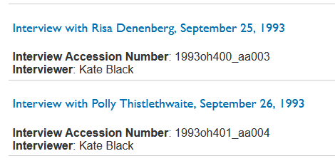
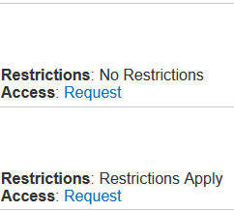
Permission to Use Existing Data
Anything that has been published is generally acceptable for academic use, unless it contains other restrictions or could cause harm to private individuals.

Slide 20
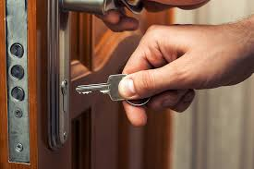
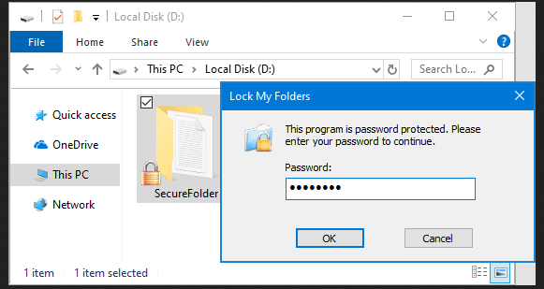


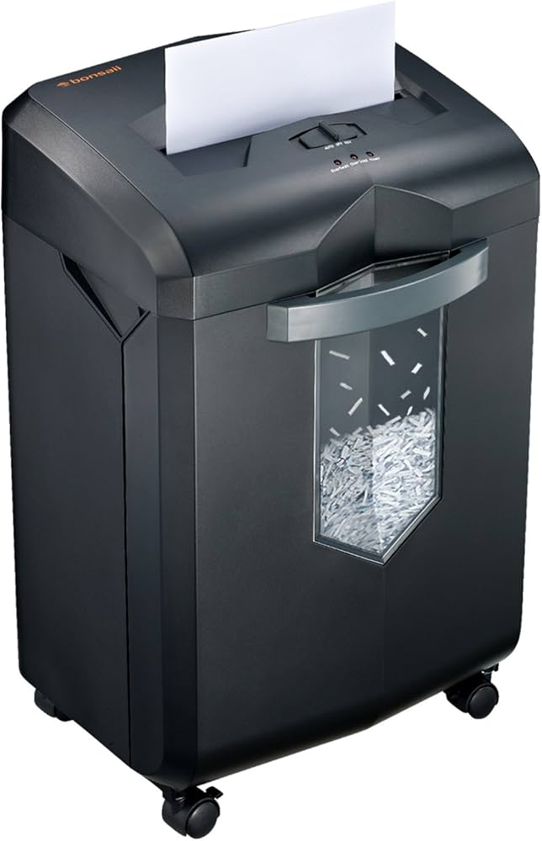

Data Plan
Notes:
This helps you protect the confidentiality and anonymity of participants

Slide 21
MINIMIZE RISK OF HARM TO PARTICIPANTS
What steps might you to take to protect participants?
Can you think of an experiment where this would be a necessary question?
Notes:
How to mitigate harm:
Reaffirm participant consent – they do not have to answer questions they are uncomfortable with
this necessary information? (the answer is not immediately clear)
- Next slide… don’t collect unnecessary information

Slide 22

Only Collect Necessary Information
Notes:
Put screenshot of Labov’s book on life & death narratives ← in this case, the question is immediately relevant
In other cases, a question that is less likely to cause distress may be more appropriate.

Slide 23

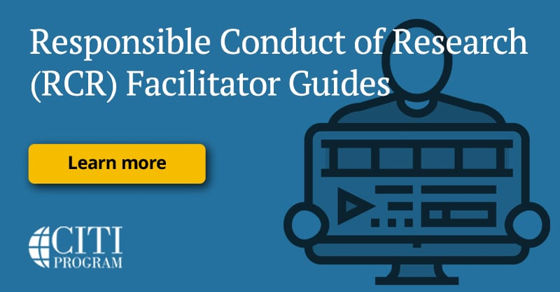
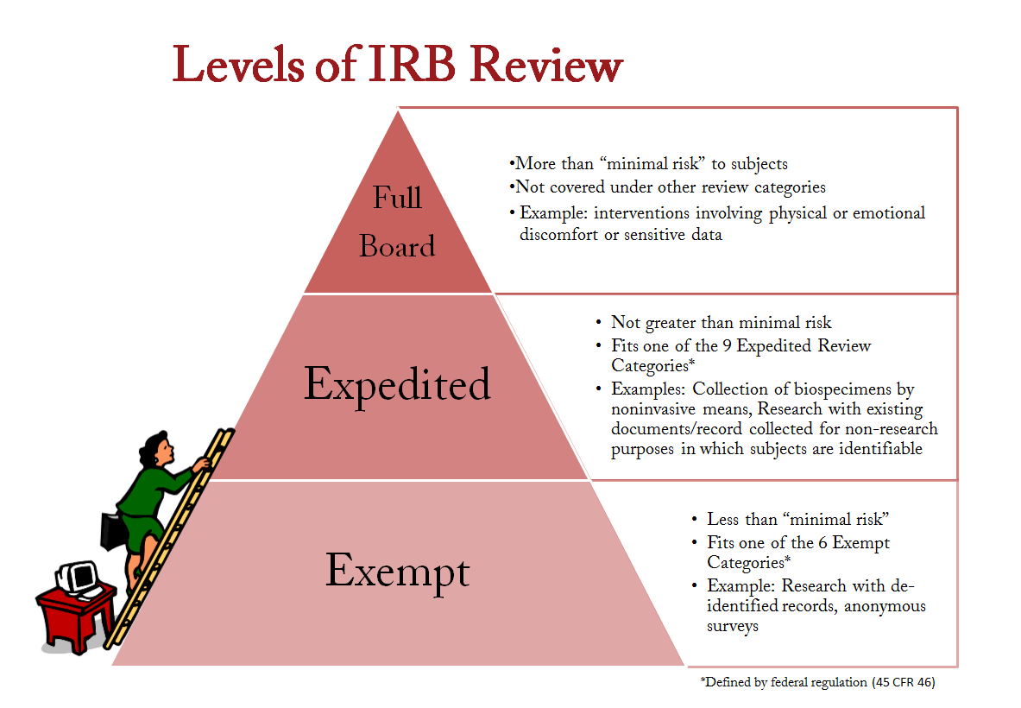

ACCOUNTABILITY AND oversight
Notes:
Many universities require training before allowing scholars to conduct research
The IRB exists to ensure the research being conducted at an institutional is being done ethically
Before conducting research, researchers submit a proposal to the IRB
The IRB assesses the level of risk to the subjects, and the researcher’s plan at all stages (recruitment, data collection, data storage / destruction, etc)

Slide 24
Attendance question
What’s next?
What demographic information would you need from survey participants to answer the question “Where, exactly, do people use different words for a carbonated beverage?”
Midterm assignments due October 19th
  Data Collection
  Questions about Methods and Ethics
New module: Language in the World
  Wednesday: How do kids learn to talk?

